Slide 1



Slide 2
ARM MOTION REPLICATOR USING ELECTROMYOGRPHY (EMG)
FINAL DEFENCE
SUPERVISED BY : ENGR. WALEED MANZOOR

Slide 3
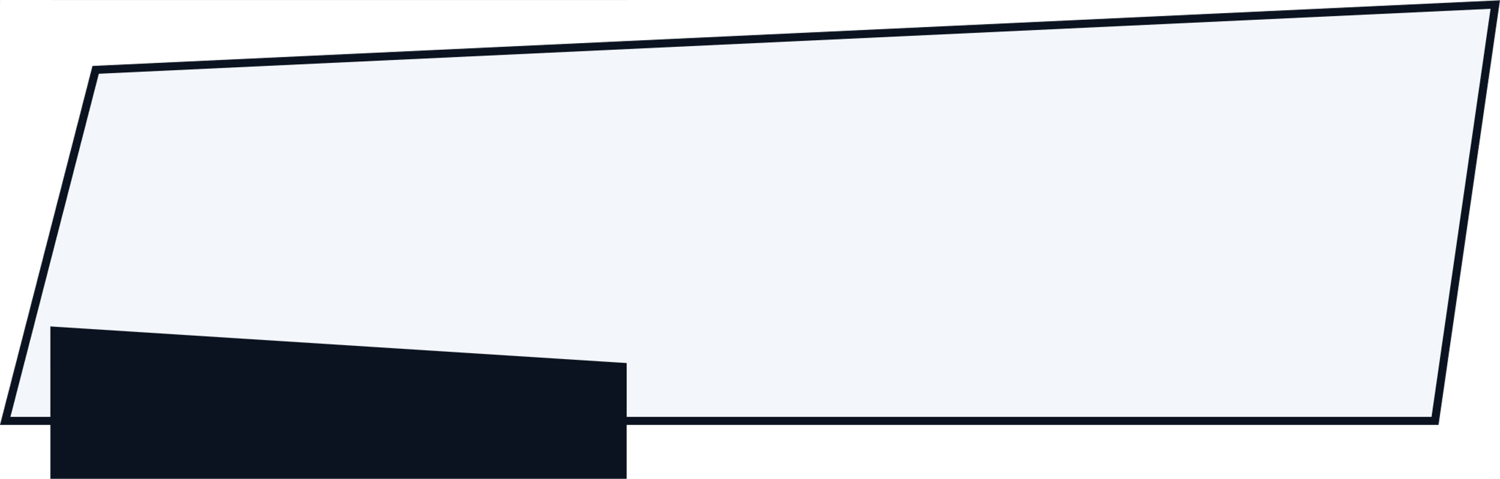
Team Members
Daniyal Chaudhary
01-132202-009
Aliza Khan
01-132202-047
Ahsan Hayat
01-132202-047

Slide 4
Contents
01
Introduction
05
Methodology
02
Problem Statement
06
Results
03
Objectives
07
Demonstration
04
Literature Review

Slide 5
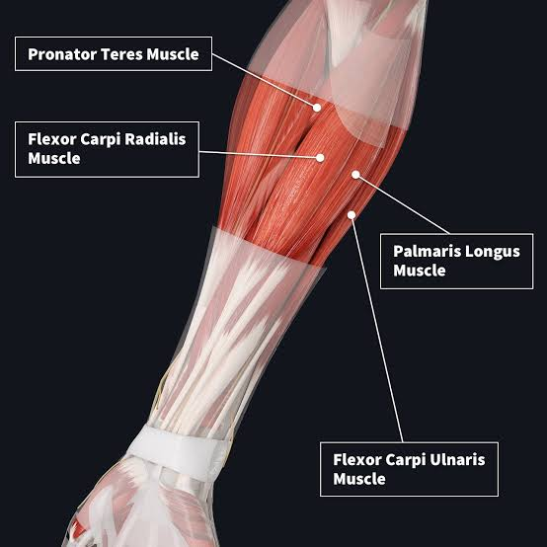
INTRODUCTION
Monoplegia
Electromyography
Non-Invasive
Natural and Intuitive Control

Slide 6
Introduction
PROBLEM STATEMENT
“To develop cost effective wearable prosthetic arm using EMG signals for rehabilitation enable more natural and independent intuitive movements for upper limbs we use a cost effective operated through Physiotherapy.”

Slide 7
LITERATURE REVIEW
Year | Research Paper | Technique used | Purpose | Analysis | Performance
2022 | Designing Prosthetic Hands With Embodied Intelligence: The KIT Prosthetic Hands | SVM ANN | This paper aims to introduce EMG based advanced prosthetic hands with onboard sensors and computing for semi-autonomous grasping, addressing limitations in user control effort and intuitiveness-of-use in myoelectric prostheses. | The hands' intelligence is attained through the integration of adaptive underactuated mechanisms, a multi-modal sensor system, and a resource-aware embedded system for processing sensory information and control on board. | 89.51 %.
2019 | Electromyogram Signal Enhancement and Upper-Limb Myoelectric Pattern Recognition | ANN SVM Naive Baise LDA | The goal of this work is to overcome issues such as ECG interference by employing surface electromyogram (EMG) data to enhance the control of powered prostheses. | In a real-time study on seven subjects, SVM outperformed LDA when combined with four features for analyzing six channels of surface EMG signals. | 85.9%.

Slide 8
2019 | Real-Time EMG Based Pattern Recognition Control for Hand Prostheses: A Review on Existing Methods, Challenges and Future Implementation | ANN KNN SVM Linear regression Nonlinear regression HMM LDA | The research focuses on enhancing myoelectric prosthesis adaptability for upper limb amputees using modified machine learning schemes. | HMM was successful in myosignal recognition with an accuracy of 94.63%. Four combinations of LDA and SVM, particularly those including OFNDA and LDA, also demonstrated good accuracy. | 89.63%
2022 | Multi-day dataset of forearm and wrist electromyogram for hand gesture recognition and biometrics | SVM LDA DNN | The research uses hand gestures and biometrics in conjunction with muscle signals (EMG) to provide unique personal identity that improves security. | Even with basic architectures, advanced techniques like deep neural networks (DNN) have produced extremely accurate classification performance. | Not given

Slide 9
2022 | Open Access Dataset for Electromyography based Multi-code Biometric Authentication | ANN SVM | The research paper explores surface EMG's dual role as both a secure biometric trait and a gesture recognition method for prosthetic control. It aims to establish EMG's effectiveness in providing a secure and customizable authentication system. | The analysis underscores the security risks of traditional biometrics and positions surface EMG as a robust dual-functional trait, offering both gesture recognition and biometric authentication. | 90.2%
2021 | Implementation of EMG Signal Measurement for the Control of the 3D Hand Prototype | ANN | The research focuses on cost-effective hand prosthesis development through a measuring stand for electromyographic and clamp force signals | EMG signals, representing muscle activity, are commonly measured on the surface due to non-invasiveness, despite the presence of interference. | Not given

Slide 10
﻿METHODOLOGY
01
02
OFFLINE DATASET
REAL-TIME DATA

Slide 11
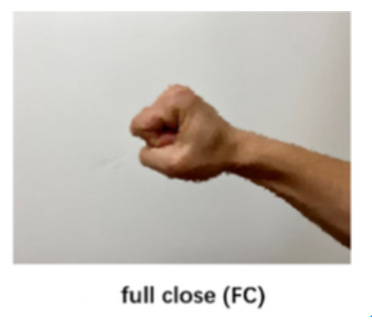
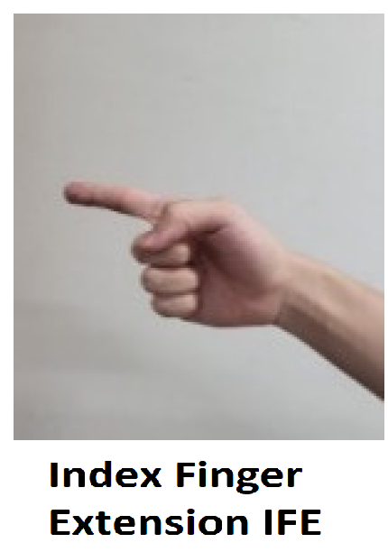
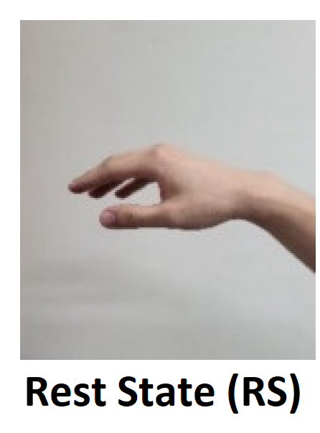
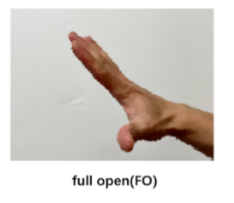
﻿METHODOLOGY
01
OFFLINE DATASET :
GrabMyo IEEE Dataport
Dataset Description
Dataset Composition

Slide 12
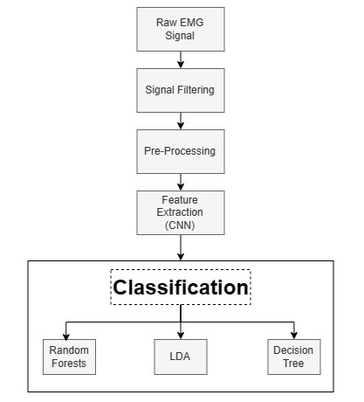
)
﻿METHODOLOGY
Signal Filtering
Signal Pre-processing
Feature Extraction
Classification

Slide 13
﻿DATA PRE-PROCESSING
Data Filtering:
Butterworth Bandpass Filter 4th order (10–500 Hz)
Notch Filter (60 Hz)

Slide 14
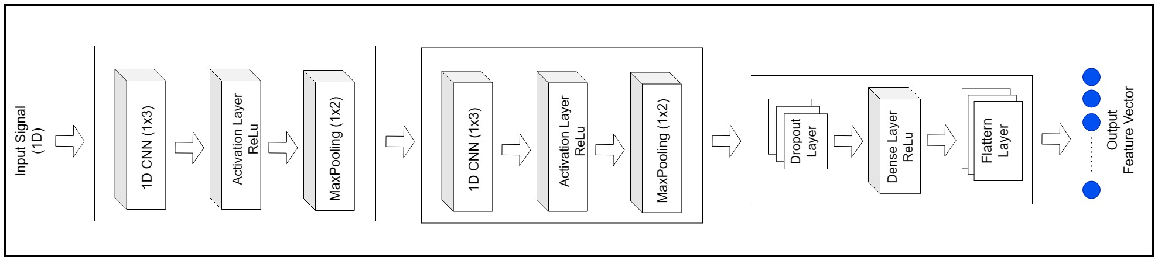
)
﻿FEATURE EXTRACTION
﻿CNN Architecture
Input Layer, Convolution Layer, Max-pooling Layer, Flatten Layer

Slide 15
)
﻿CLASSIFICATION
Linear Discriminant Analysis Classifier
Random Forest Classifier
Fine Decision Tree

Slide 16
﻿RESULTS OF OFFLINE DATASET
Classifiers | Fine Decision Tree | Random Forest | Linear Discriminant Analysis
Standard Deviation | 5.258191 | 3.514094 | 3.720668
Average Accuracy | 87.21% | 91.87% | 88.75%
Variance | 0.276486 | 0.123489 | 0.138434

Slide 17
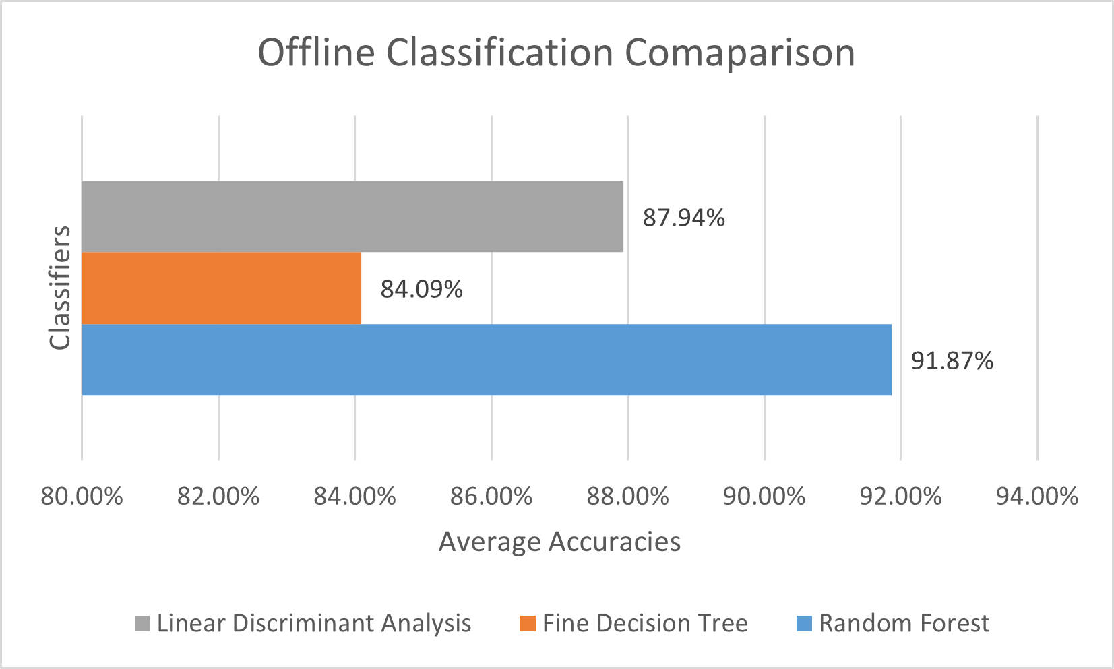
﻿RESULTS OF OFFLINE DATASET
Random Forest gives Highest Accuracy (91.87%)
Linear Discriminant Analysis gives moderate Accuracy (87.94%)
Fine Decision Tree gives the lowest Accuracy (84.09%)

Slide 18
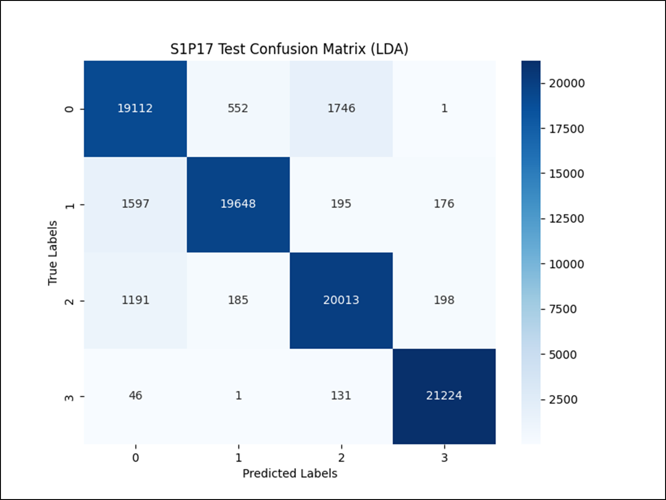

﻿RESULTS OF OFFLINE DATASET

Slide 19
﻿METHODOLOGY
02
REAL-TIME DATA :
Data Acquisition
2 Gestures
Processing

Slide 20
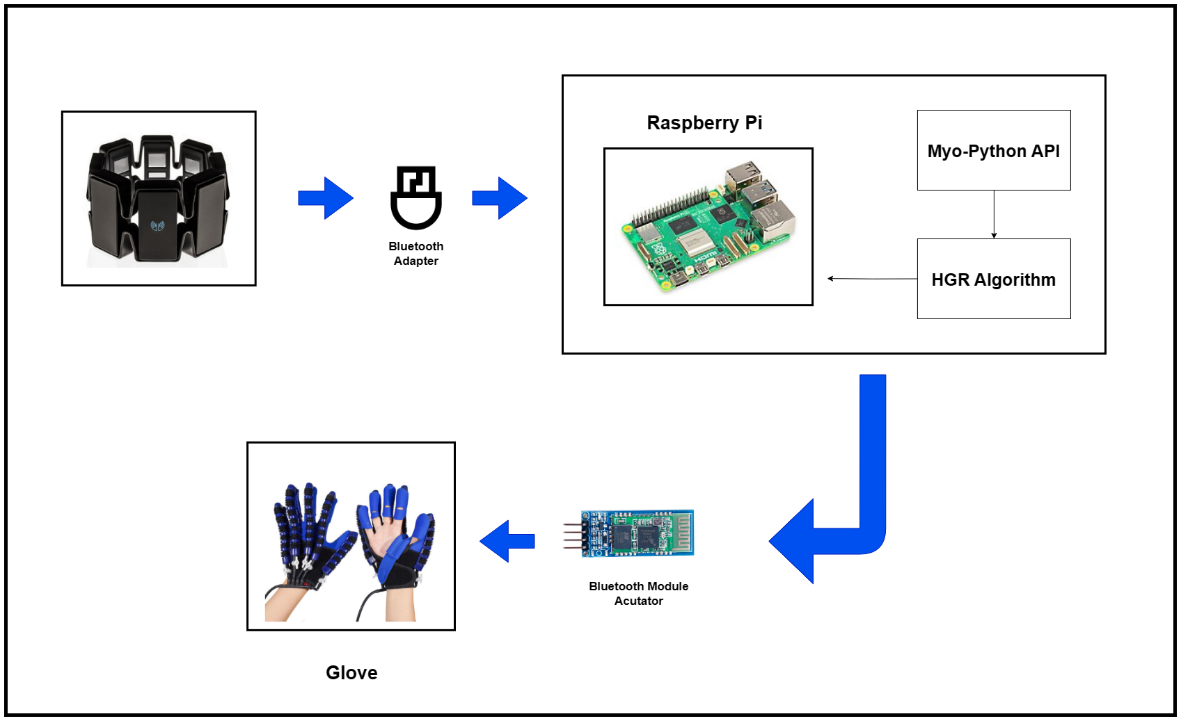
﻿METHODOLOGY OVERVIEW

Slide 21
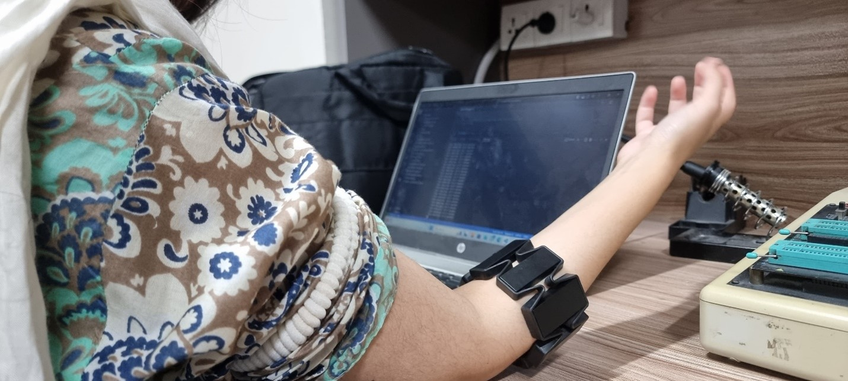
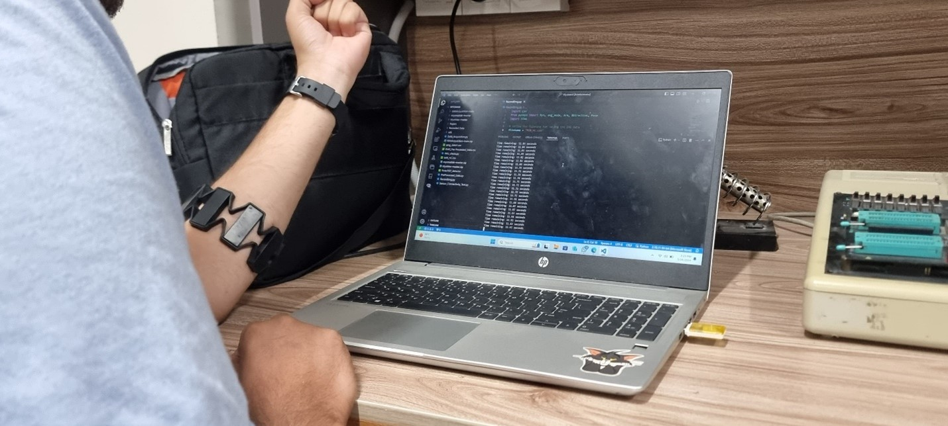
)
﻿DATA ACQUISITION
MYO Armband EMG Sensor
8 EMG Electrodes
15 Participants
2 Gesture 20 sec each

Slide 22
)
﻿METHODOLOGY
Data Acquisition
Data Pre-processing
Feature Extraction
Classification

Slide 23
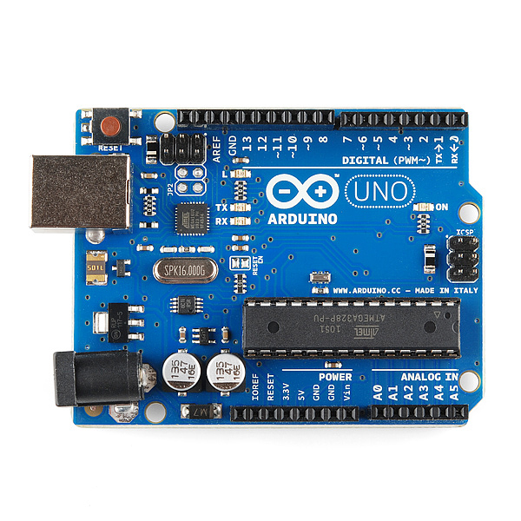
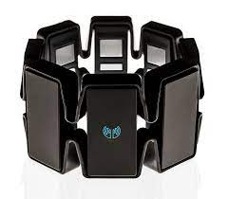
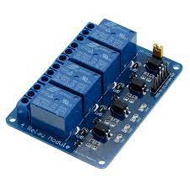
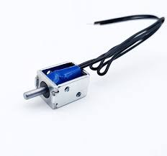
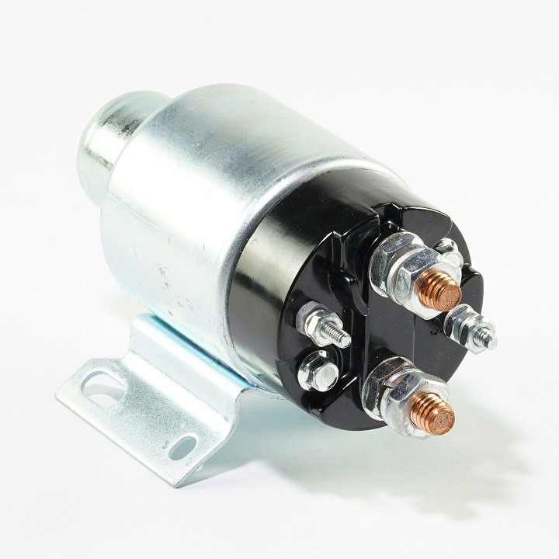
﻿HARDWARE COMPONENTS
MYO Armband EMG Sensor
DC Air Pump
Solenoids
Relay
Bluetooth Module
Arduino Uno

Slide 24
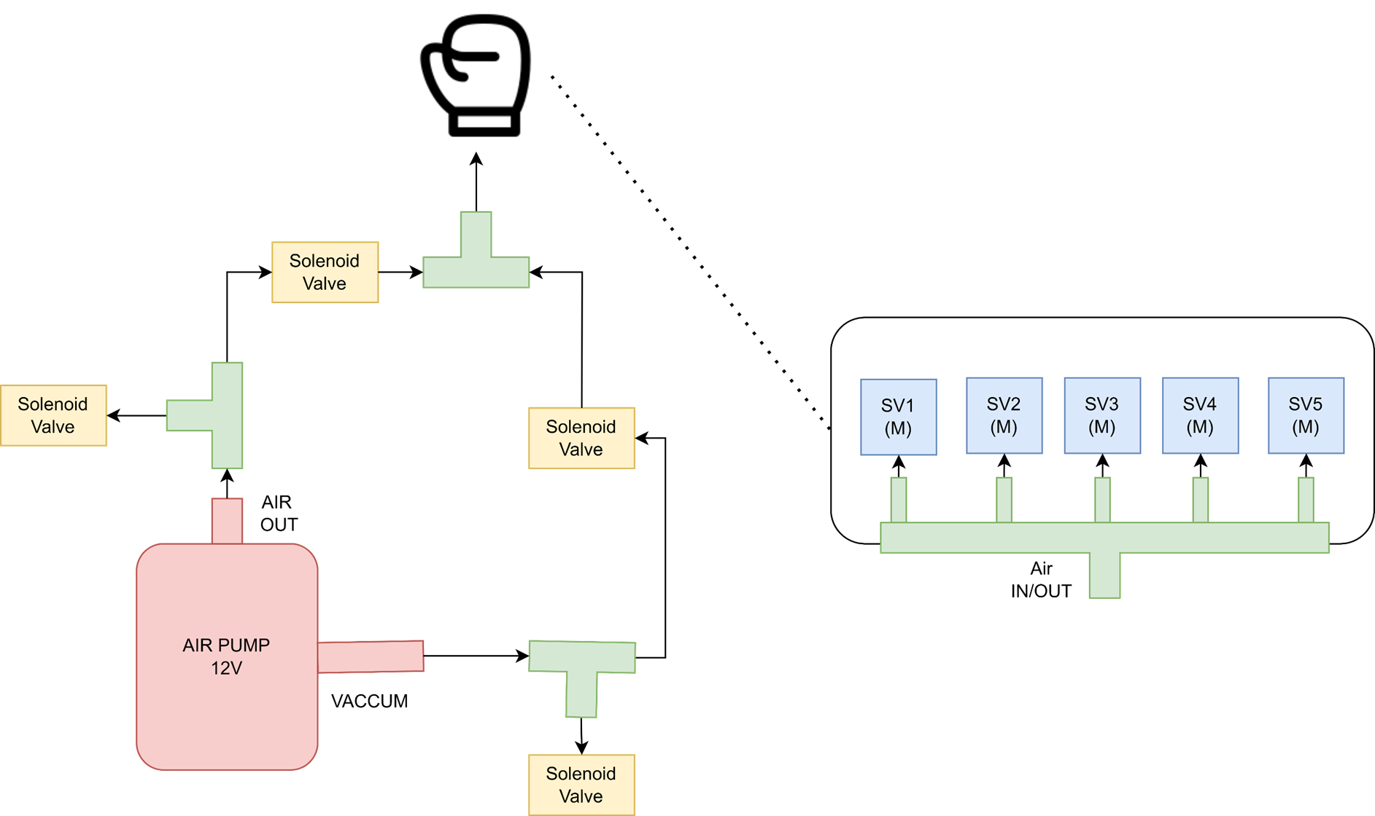
﻿GLOVE DESIGNING

Slide 25
﻿CLASSIFICATION
Linear Discriminant Analysis Classifier
Random Forest Classifier
Fine Decision Tree

Slide 26
﻿RESULTS OF REAL-TIME DATA
Classifiers | Fine Decision Tree | Random Forest | Linear Discriminant Analysis
Standard Deviation | 0.063782 | 0.053679 | 0.071356
Average Accuracy | 82.36% | 89.76% | 76.96%
Variance | 0.004068 | 0.002881 | 0.005093

Slide 27
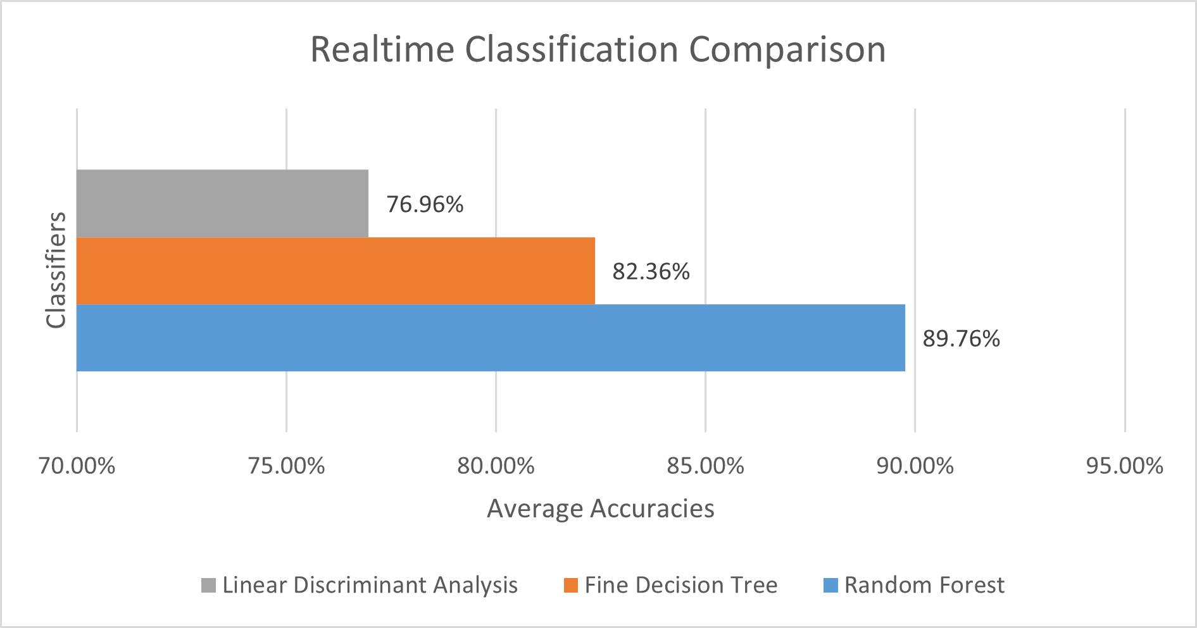
﻿RESULTS OF REAL-TIME DATA
Random Forest gives Highest Accuracy (89.76%)
Fine Decision Tree gives moderate Accuracy (82.36%)
Linear Discriminant Analysis gives the lowest Accuracy (76.96%)

Slide 28
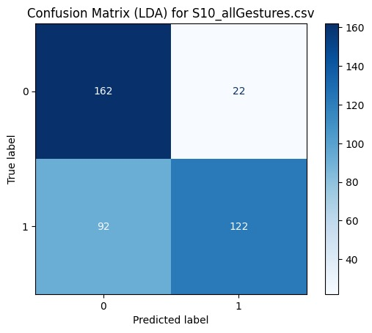
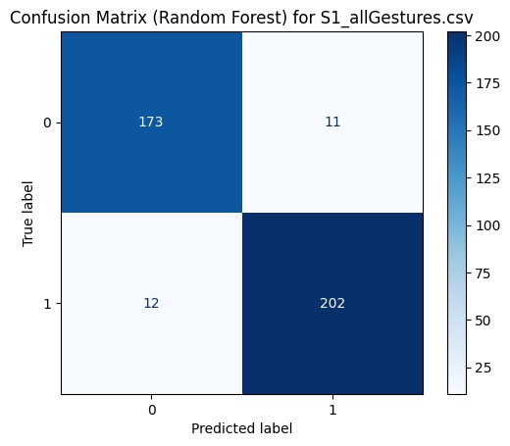
﻿RESULTS OF REAL-TIME DATA

Slide 29
COMPARISON
Offline Vs. Real-time
Classifiers | Offline Dataset | Real-time
Fine Decision Tree | 87.21% | 82.36%
Random Forest | 91.87% | 89.76%
Linear Discriminant Analysis | 88.75% | 76.96%

Slide 30
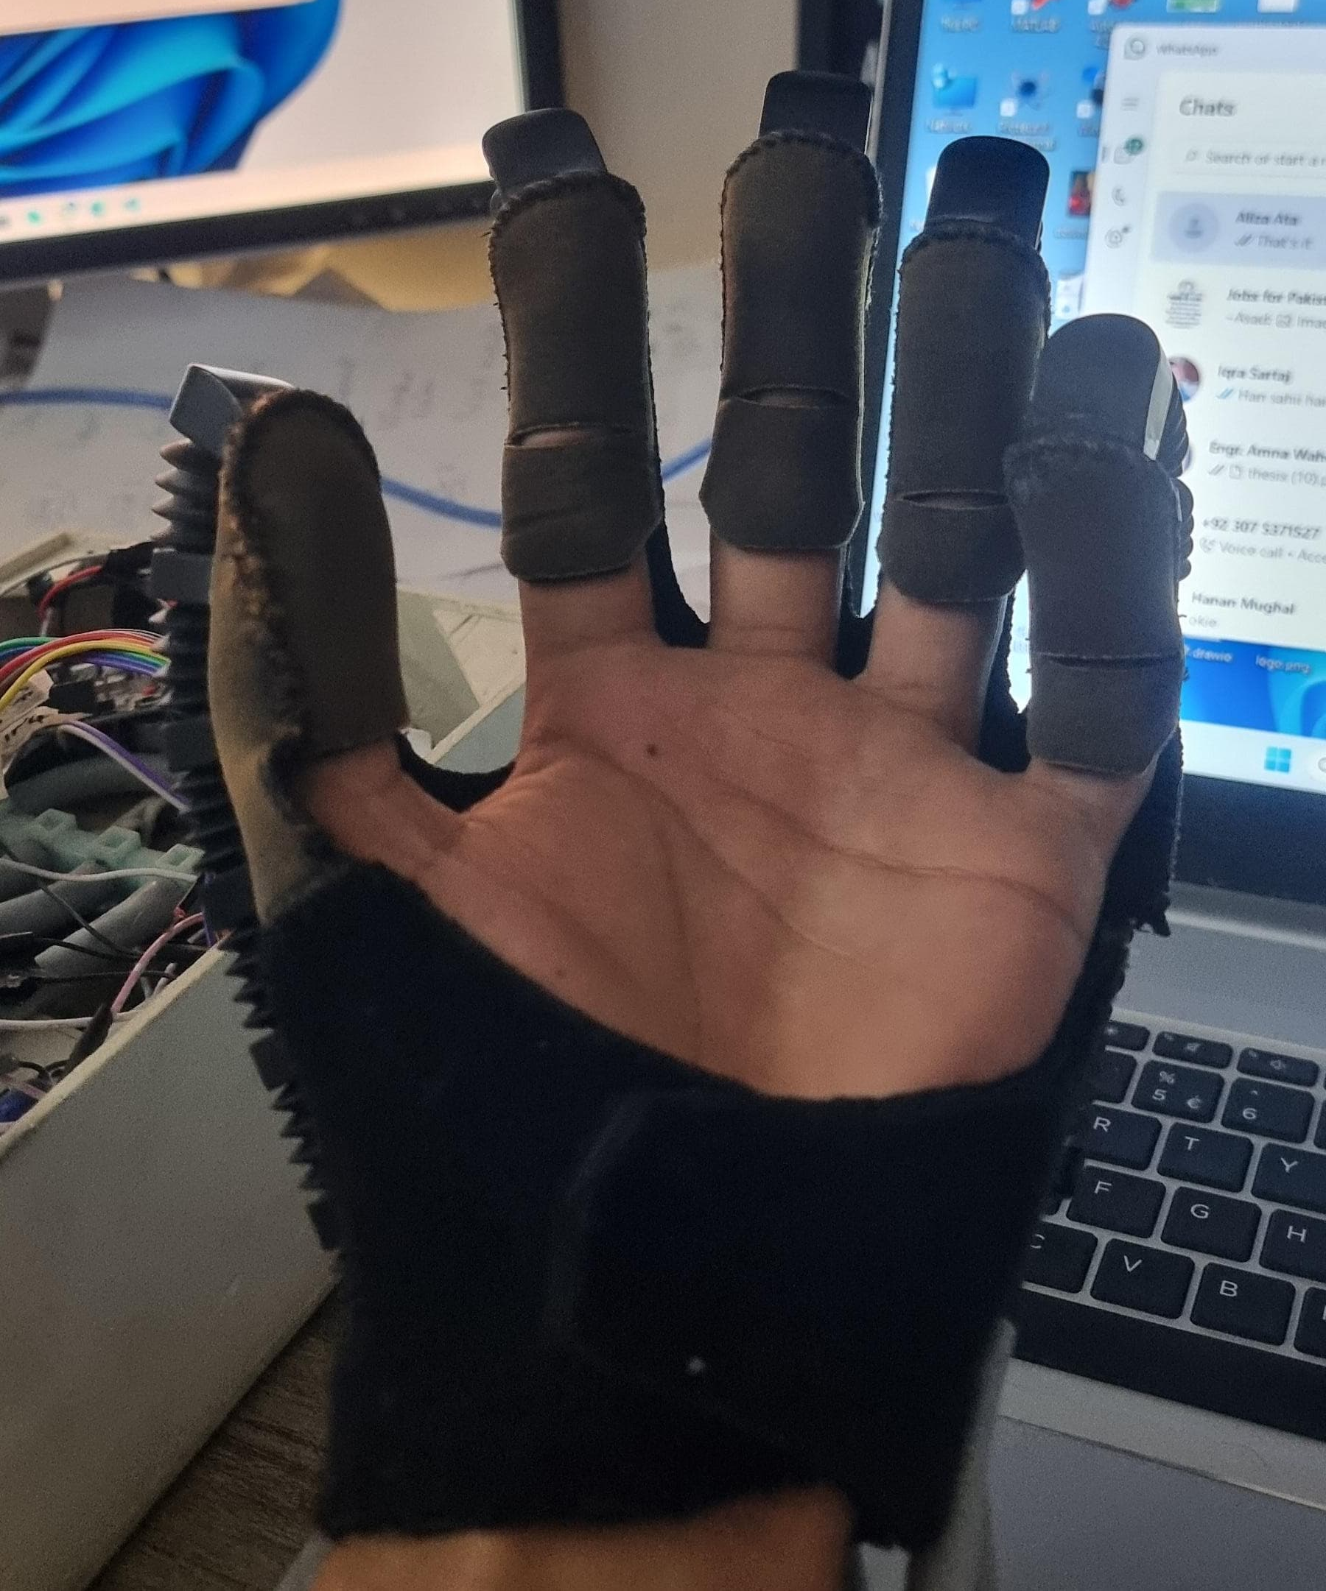
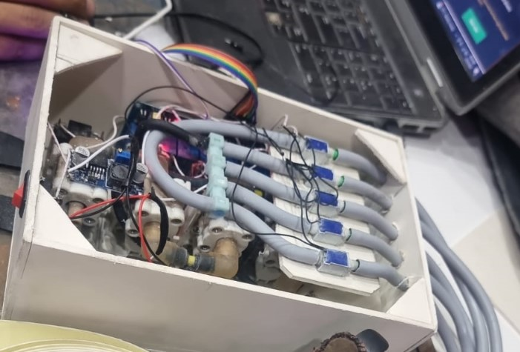
﻿GLOVE IMPLEMENTATION

Slide 31
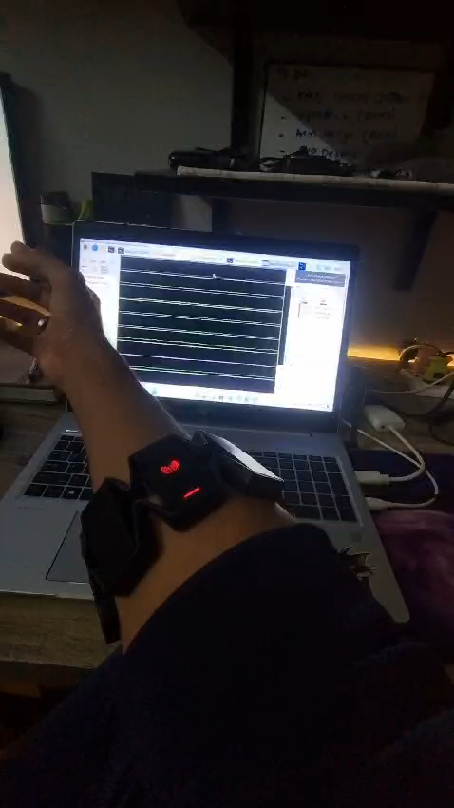
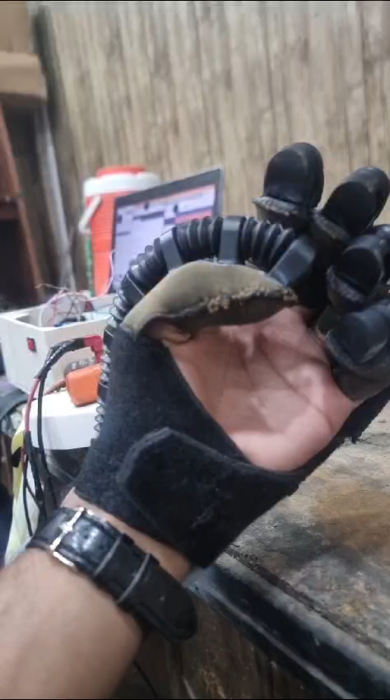
﻿VIDEO DEMONSTRATION

Slide 32
Thank You

